Slide 1
California County Poverty Levels Affecting Hospital Performance Ratings

Slide 2
Table of Contents
Meet the Team
Project Overview
Questions and Expectations
Data Description
Resources Used
Data Exploration/Clean Up Phase
Data Analysis Phase
Results
Future Recommendations and Project Review
Q&A

Slide 3




The Team - Group 4
Abhipsha Chatterjee
April Reyes
Natasha Nutley
Denisse Farias

Slide 4

Overview
We will be analyzing California counties’ poverty levels with California counties, hospitals, and performance level based on hospital procedures performed between 2016-2020 to determine and evaluate if poverty levels correlate with hospital performance and how impactful it is.
Notes:
We will be analyzing California counties’ poverty levels with California counties, hospitals, and performance level based on hospital procedures performed between 2016-2020 to determine and evaluate if poverty levels correlate with hospital performance and how impactful it is.
We thought this comparison would be interesting because social determinants of health may be higher in areas with more poverty, leading to people with less access to healthcare and resources to stay healthy leads to people with poorer health. This could contribute to more adverse events.
California is known to have a diverse population of people in all stages of financial health. This can be seen from the high-paying silicon valley to the depths of poverty of Skid Row.
Hospitals continue performing medical procedures regardless of healthcare affordability. Hospitals are rated according to the number of adverse cases and the risk-adjustment rate of the procedures performed in said hospital. Because of this some hospitals have higher ratings than others.
We want to see if there is a correlation between a county’s poverty rate and the general hospital rating of that county.

Slide 5

Questions
How will California County hospitals perform when comparing hospital ratings and the total number of adverse events?
How does a county’s percentage of poverty correlate to hospital procedure performance rating?

Slide 6
Expectations
We expect counties with higher cases of poverty to have lower performance ratings of hospital procedures performed compared to hospitals in counties with less cases of poverty.
We expect to see a higher number of adverse cases and a higher risk adjusted rate in more poverty-ridden counties with worse hospital ratings than in less poverty-ridden counties.

Slide 7
Data Description
Census.gov – dataset of California poverty census
Healthdata.gov – dataset for California Hospital Performance Ratings
Notes:
Our data has been procured from the California census website containing California poverty levels by county from the years 2016 to 2020. The other dataset contains California Hospital Performance ratings by County between the years 2016 to 2021.
For the sake of simplicity and uniformity in our analysis, we are focusing on the data between 2016 and 2020.
https://healthdata.gov/State/California-Hospital-Performance-Ratings/gyej-bbhk
https://www.census.gov/data-tools/demo/saipe/#/?s_state=06&s_county=&s_district=&s_geography=county

Slide 8

Resources
Tableau
Jupyter notebook/ Python
Mlenv for Machine learning
Time series evaluations
Notes:
For the purpose of completing this project analysis we used the following:

Slide 9
Data Exploration
Clean Up Phase
Notes:
Once we had our sources collected and verified, we were ready to begin our data exploration phase to see exactly what we were working with and how much cleanup we needed to do.

Slide 10
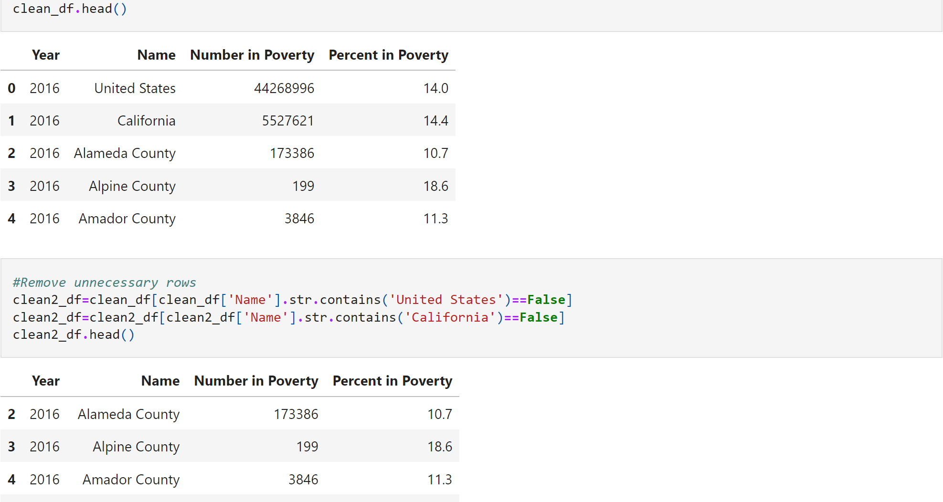
Data Cleanup for Poverty Levels
Notes:
The original dataset came with plenty of information though not all of it would be useful for our project purposes. For this reason we decided to filter out any columns that would not suite our data, such as hospital ID. We also made sure to drop any null data.

Slide 11
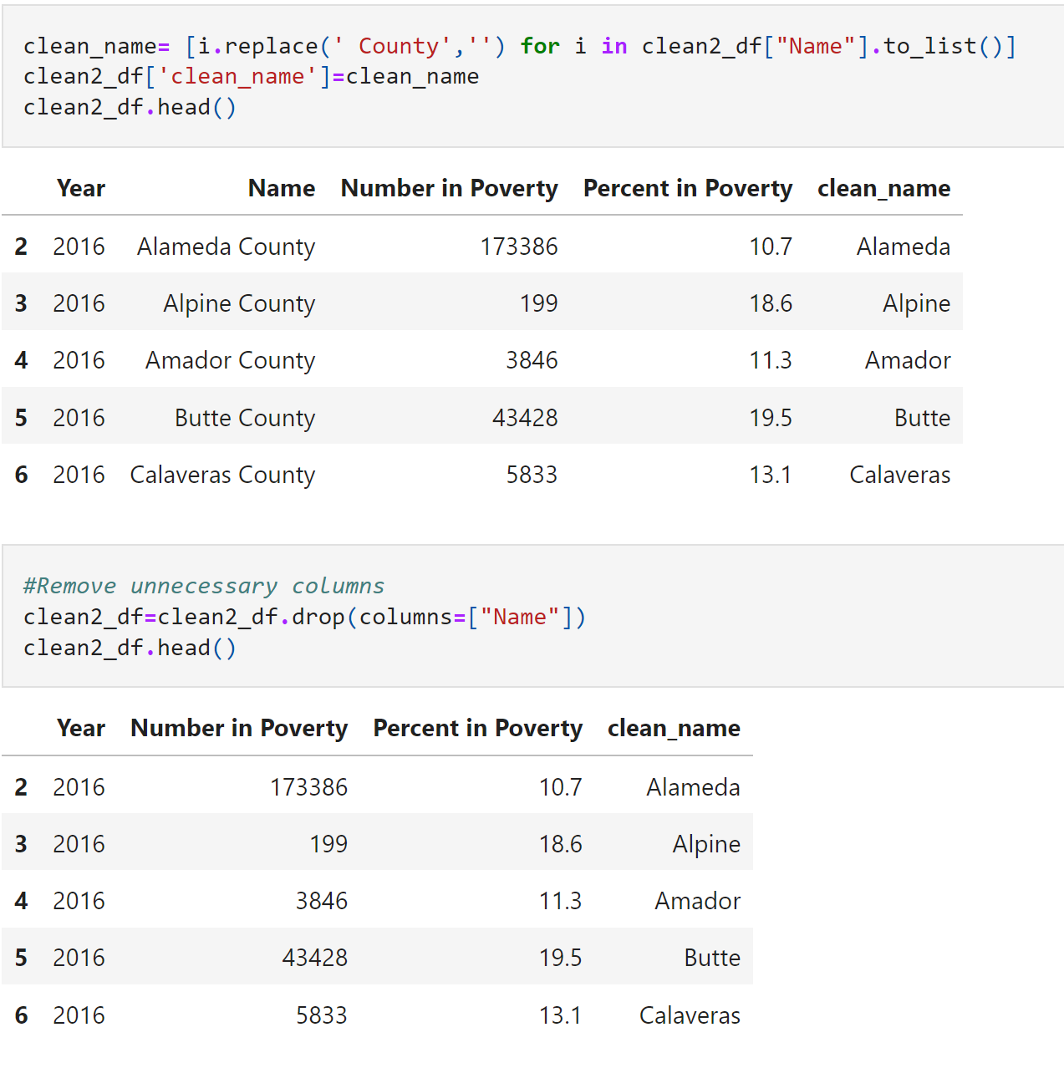
Notes:
Clean the county name column to edit out the “County” and replace the ‘Name’ column with “clean_name” column

Slide 12
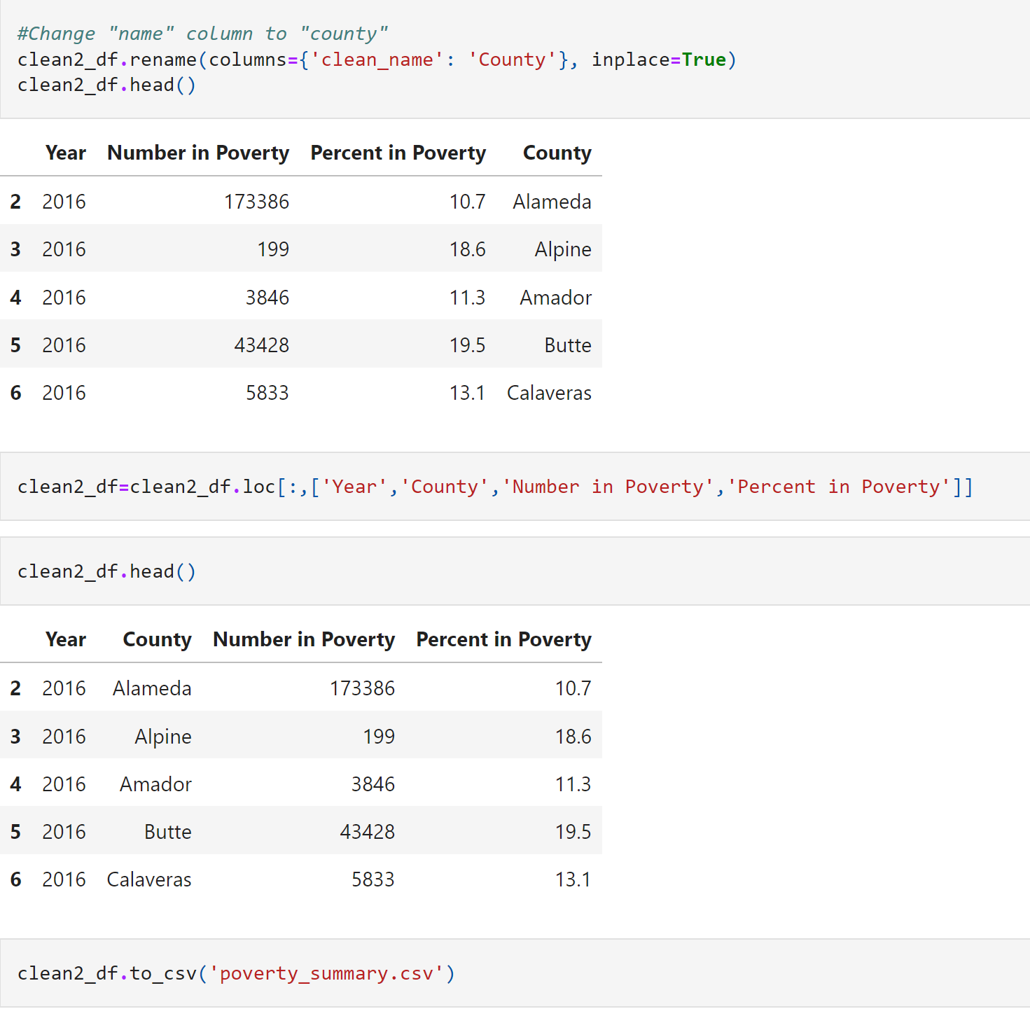
Notes:
Renaming the “Clean_Names” column to “County”.
Listing all columns in the new dataset and saving it into a csv for data analysis

Slide 13
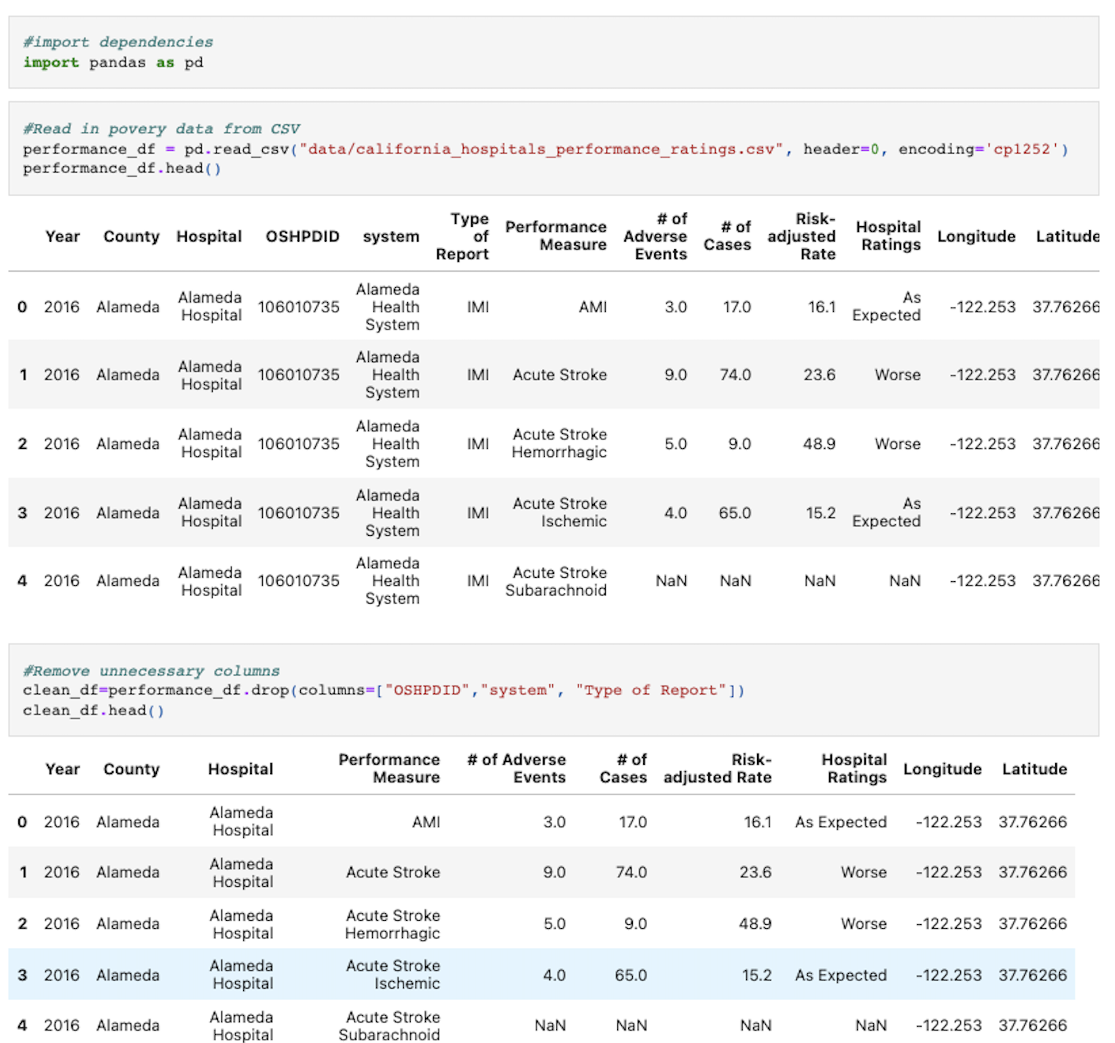
Data Cleanup for Hospital Performance Levels

Slide 14
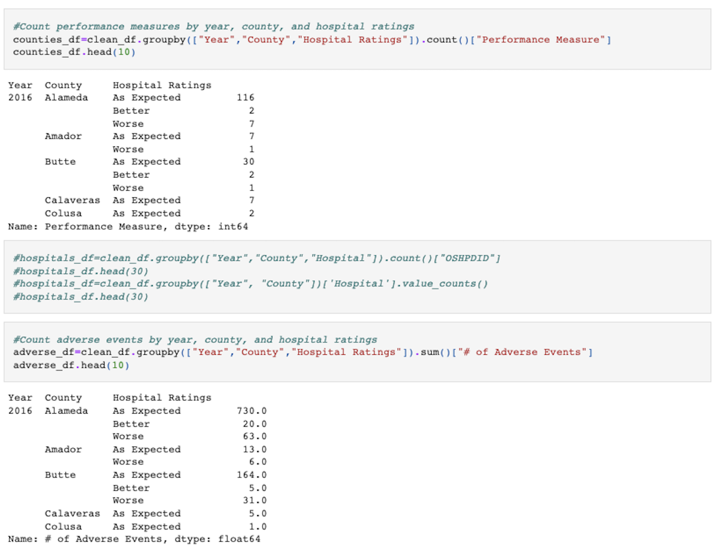

Slide 15
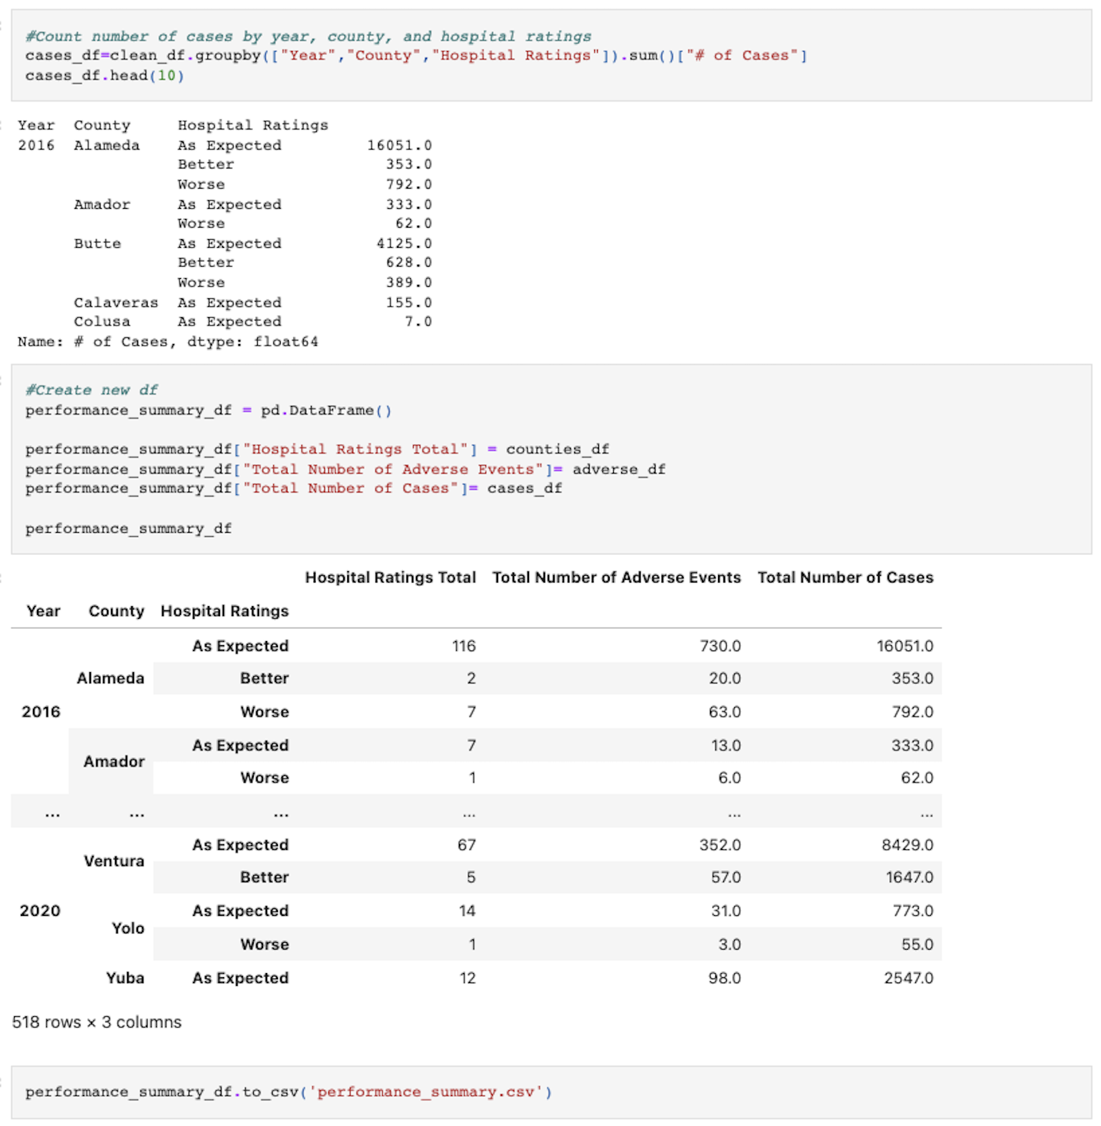

Slide 16

Data Analysis Phase
Notes:
With this data cleaned and now easier to work with, we decided it would be well to move forward with our analysis using Tableau to visualize the data and machine learning regression analysis to predict future events.

Slide 17
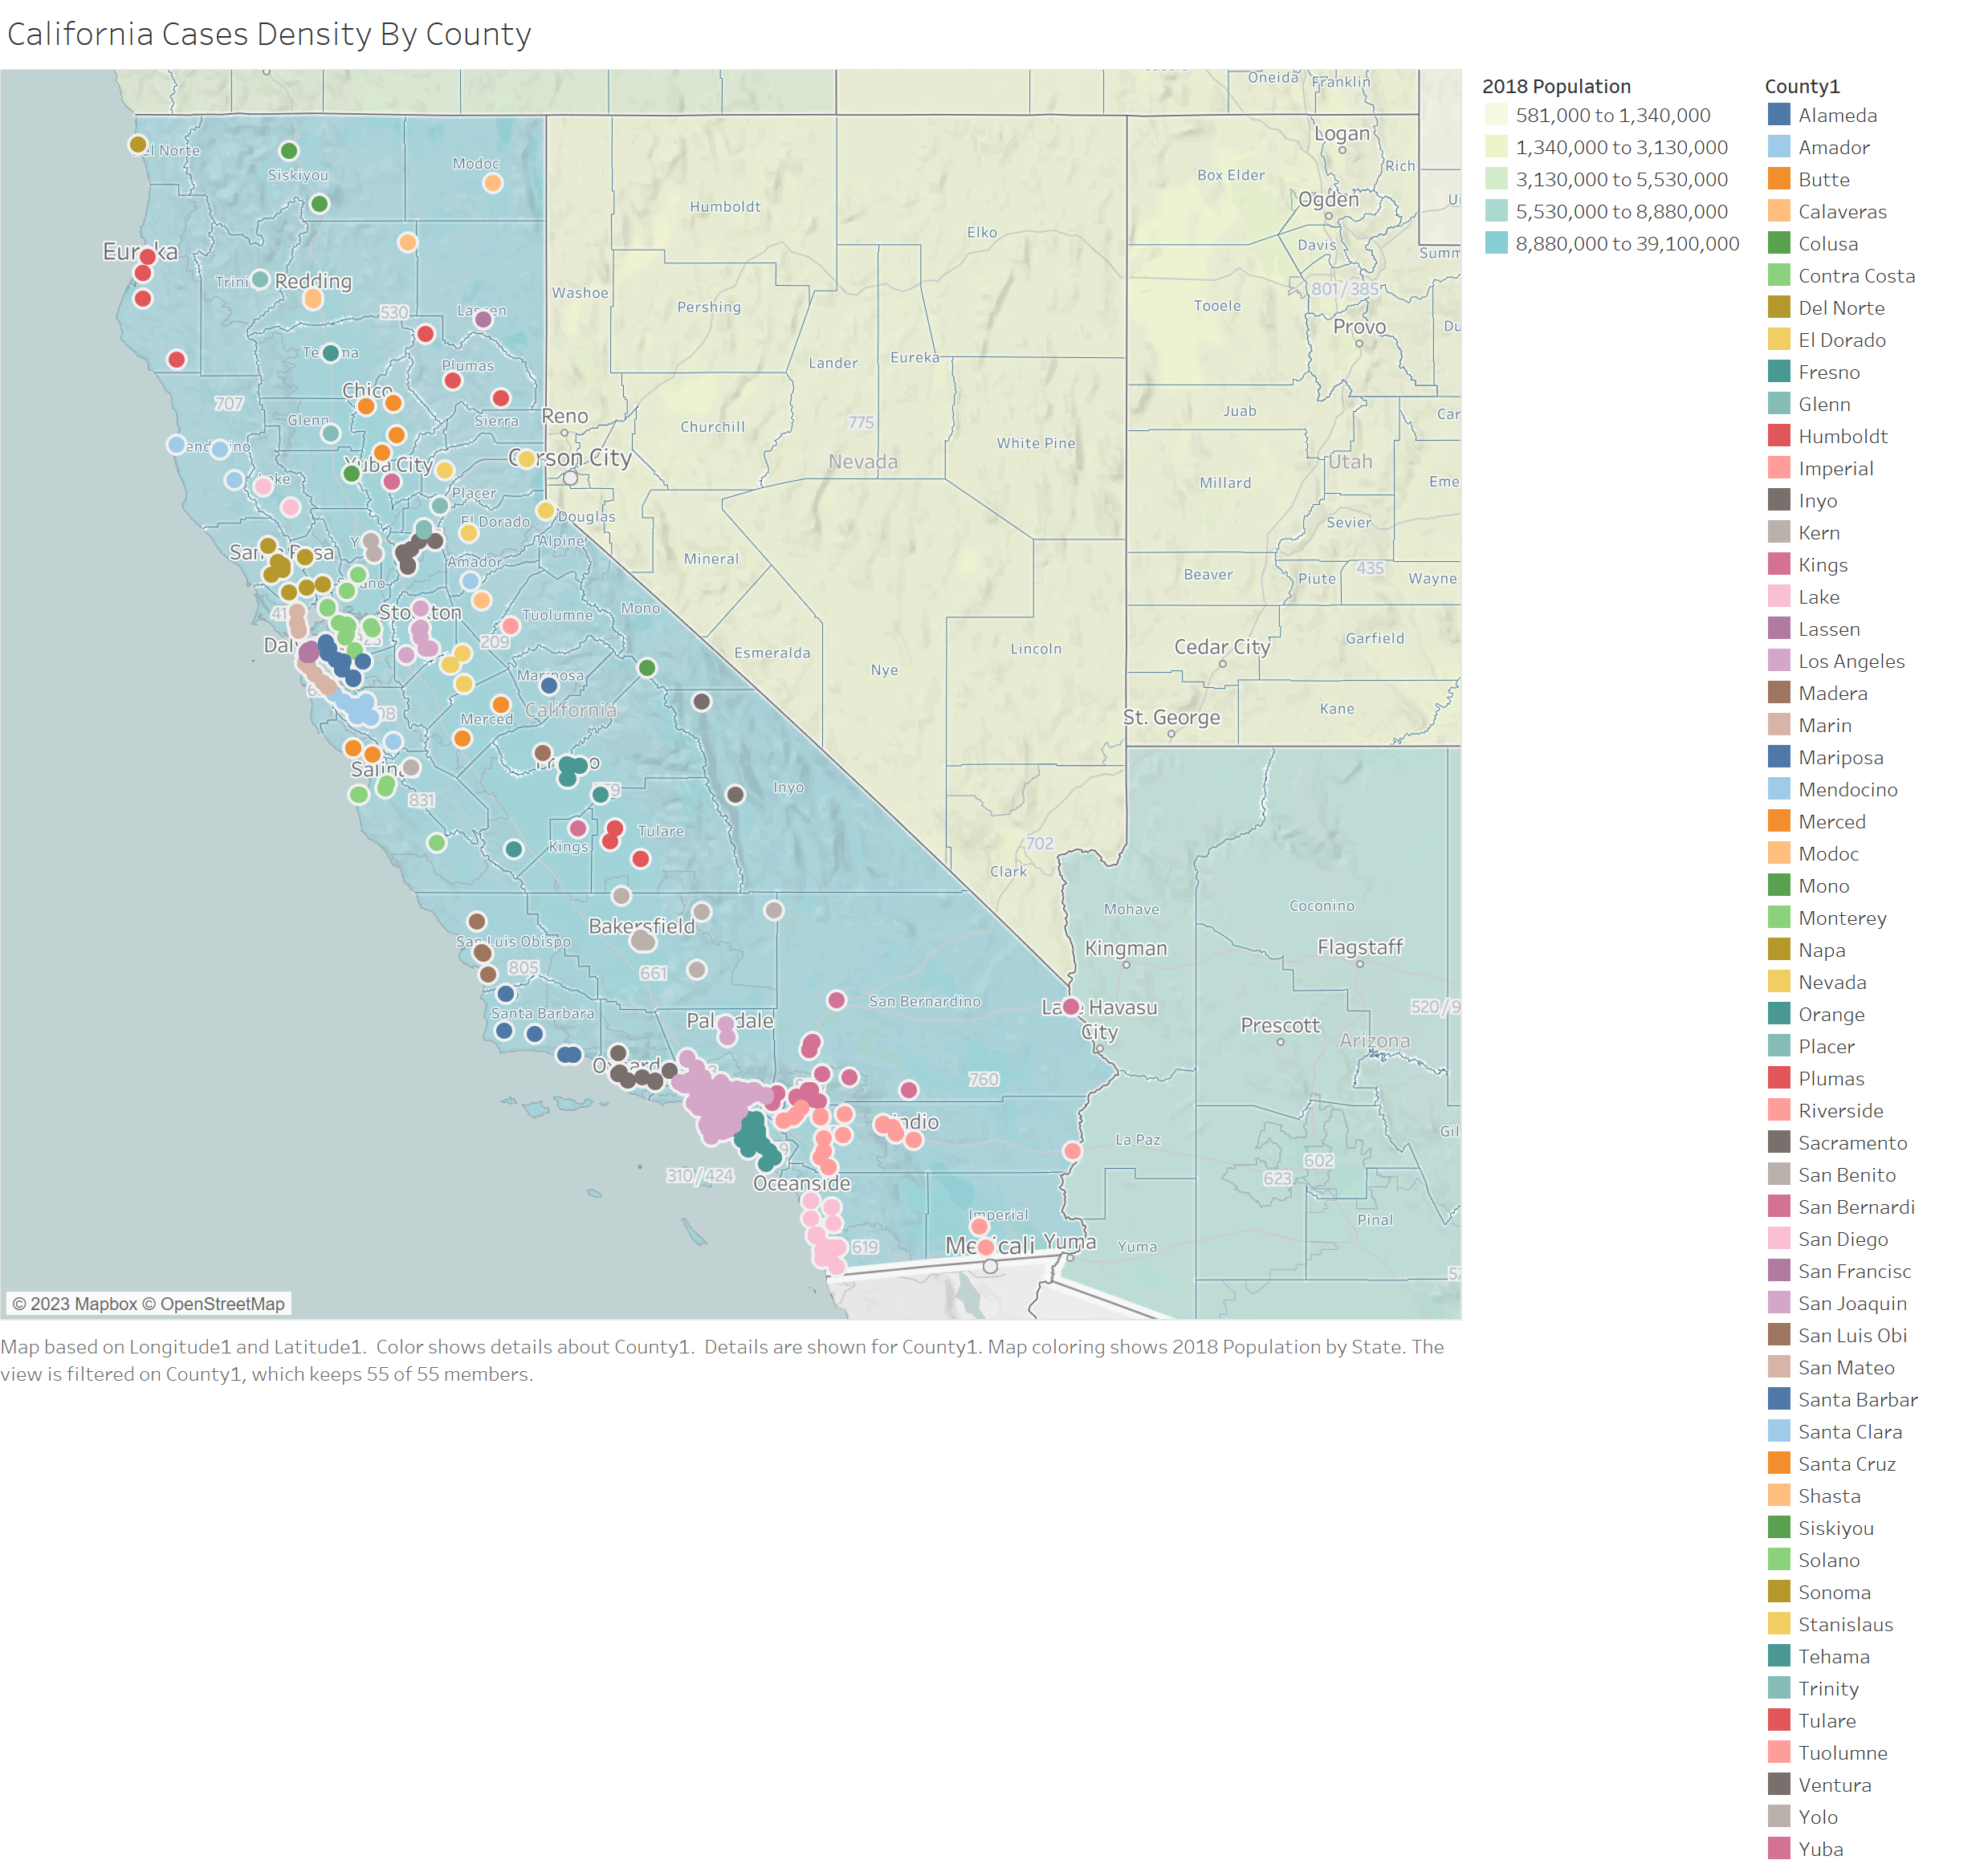

Slide 18
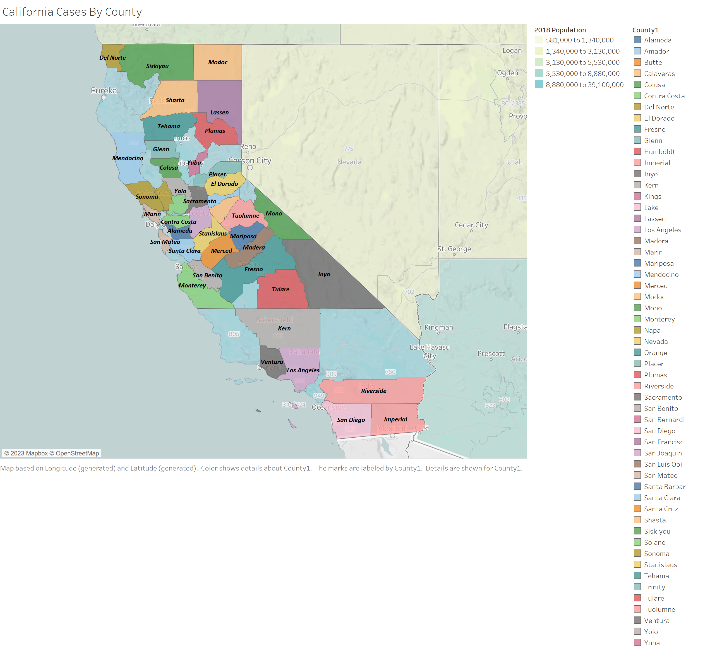

Slide 19
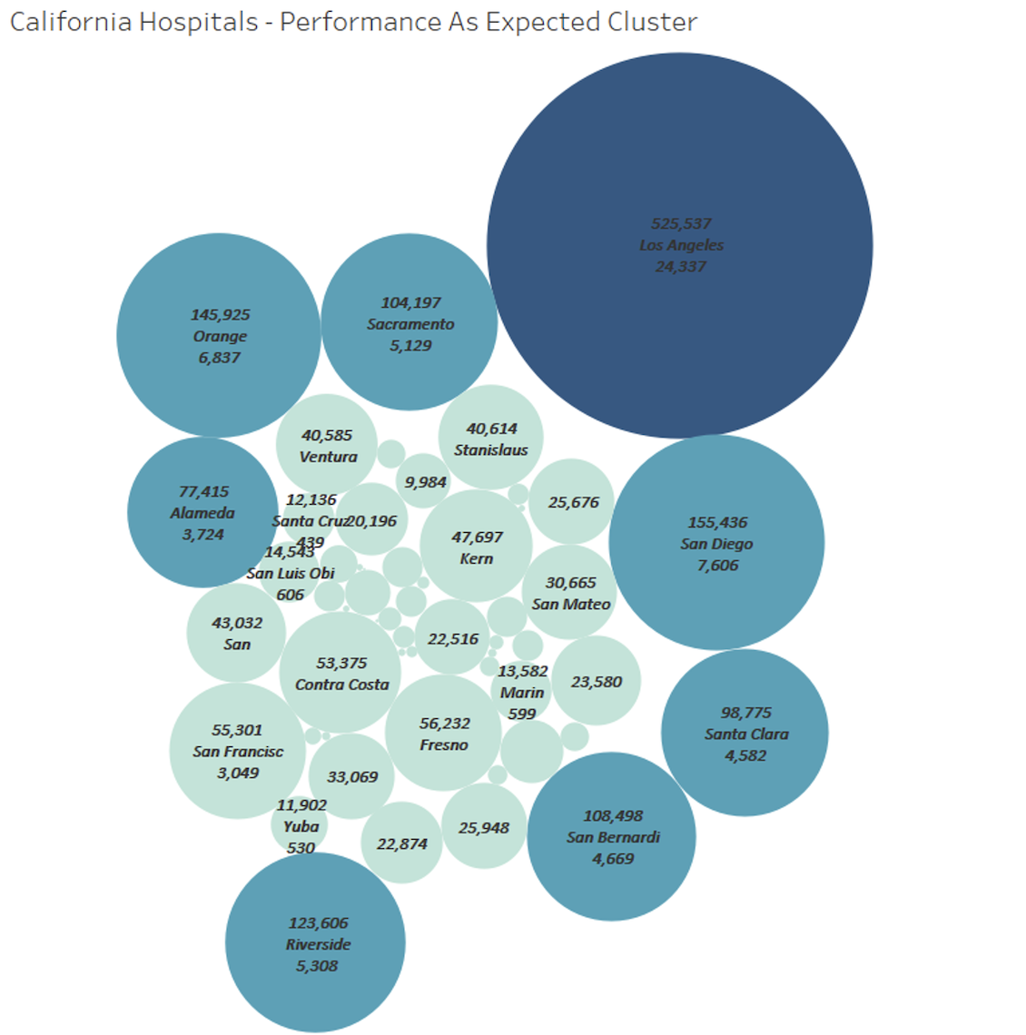

Slide 20
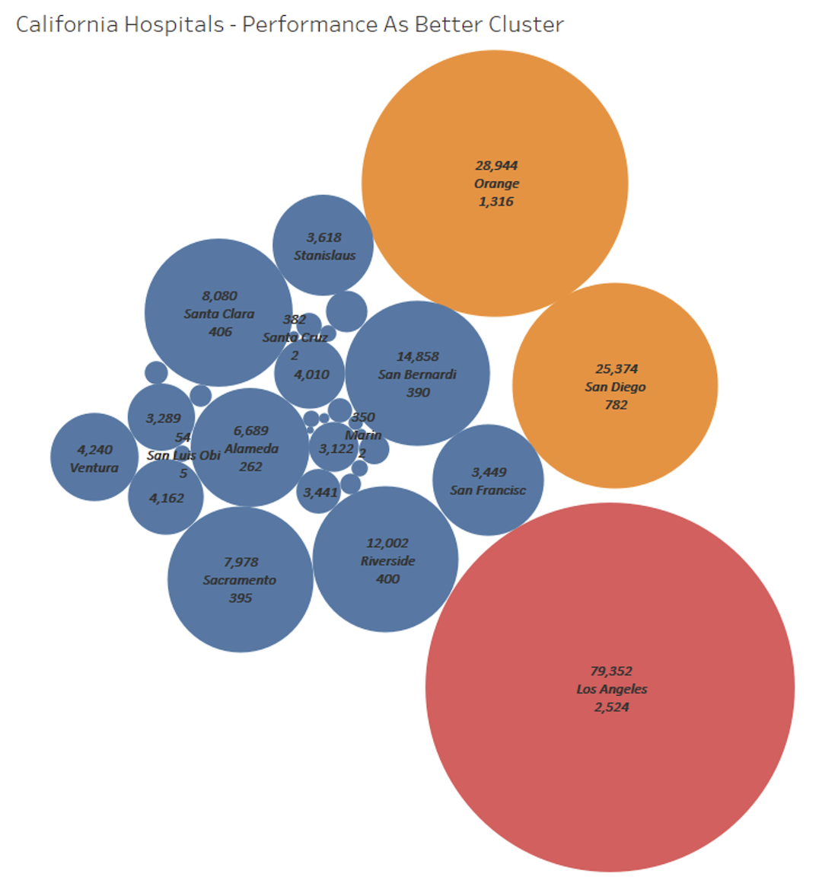

Slide 21
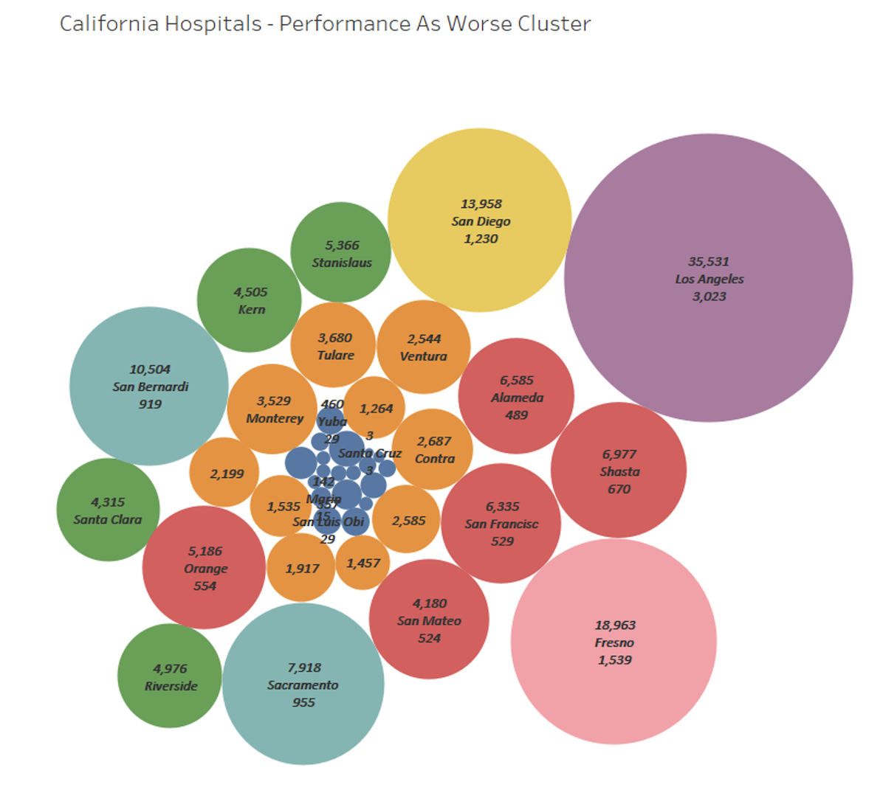

Slide 22
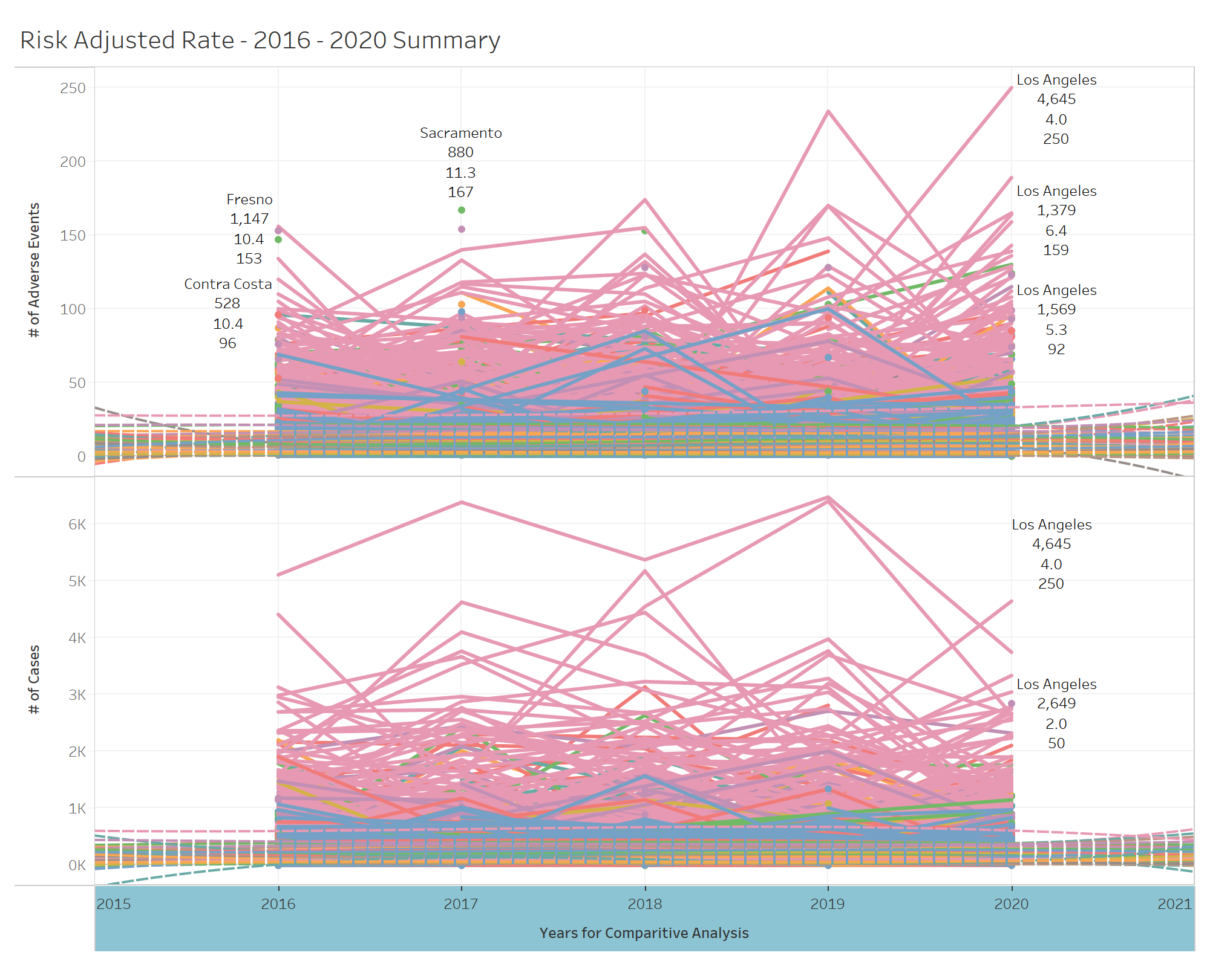

Slide 23
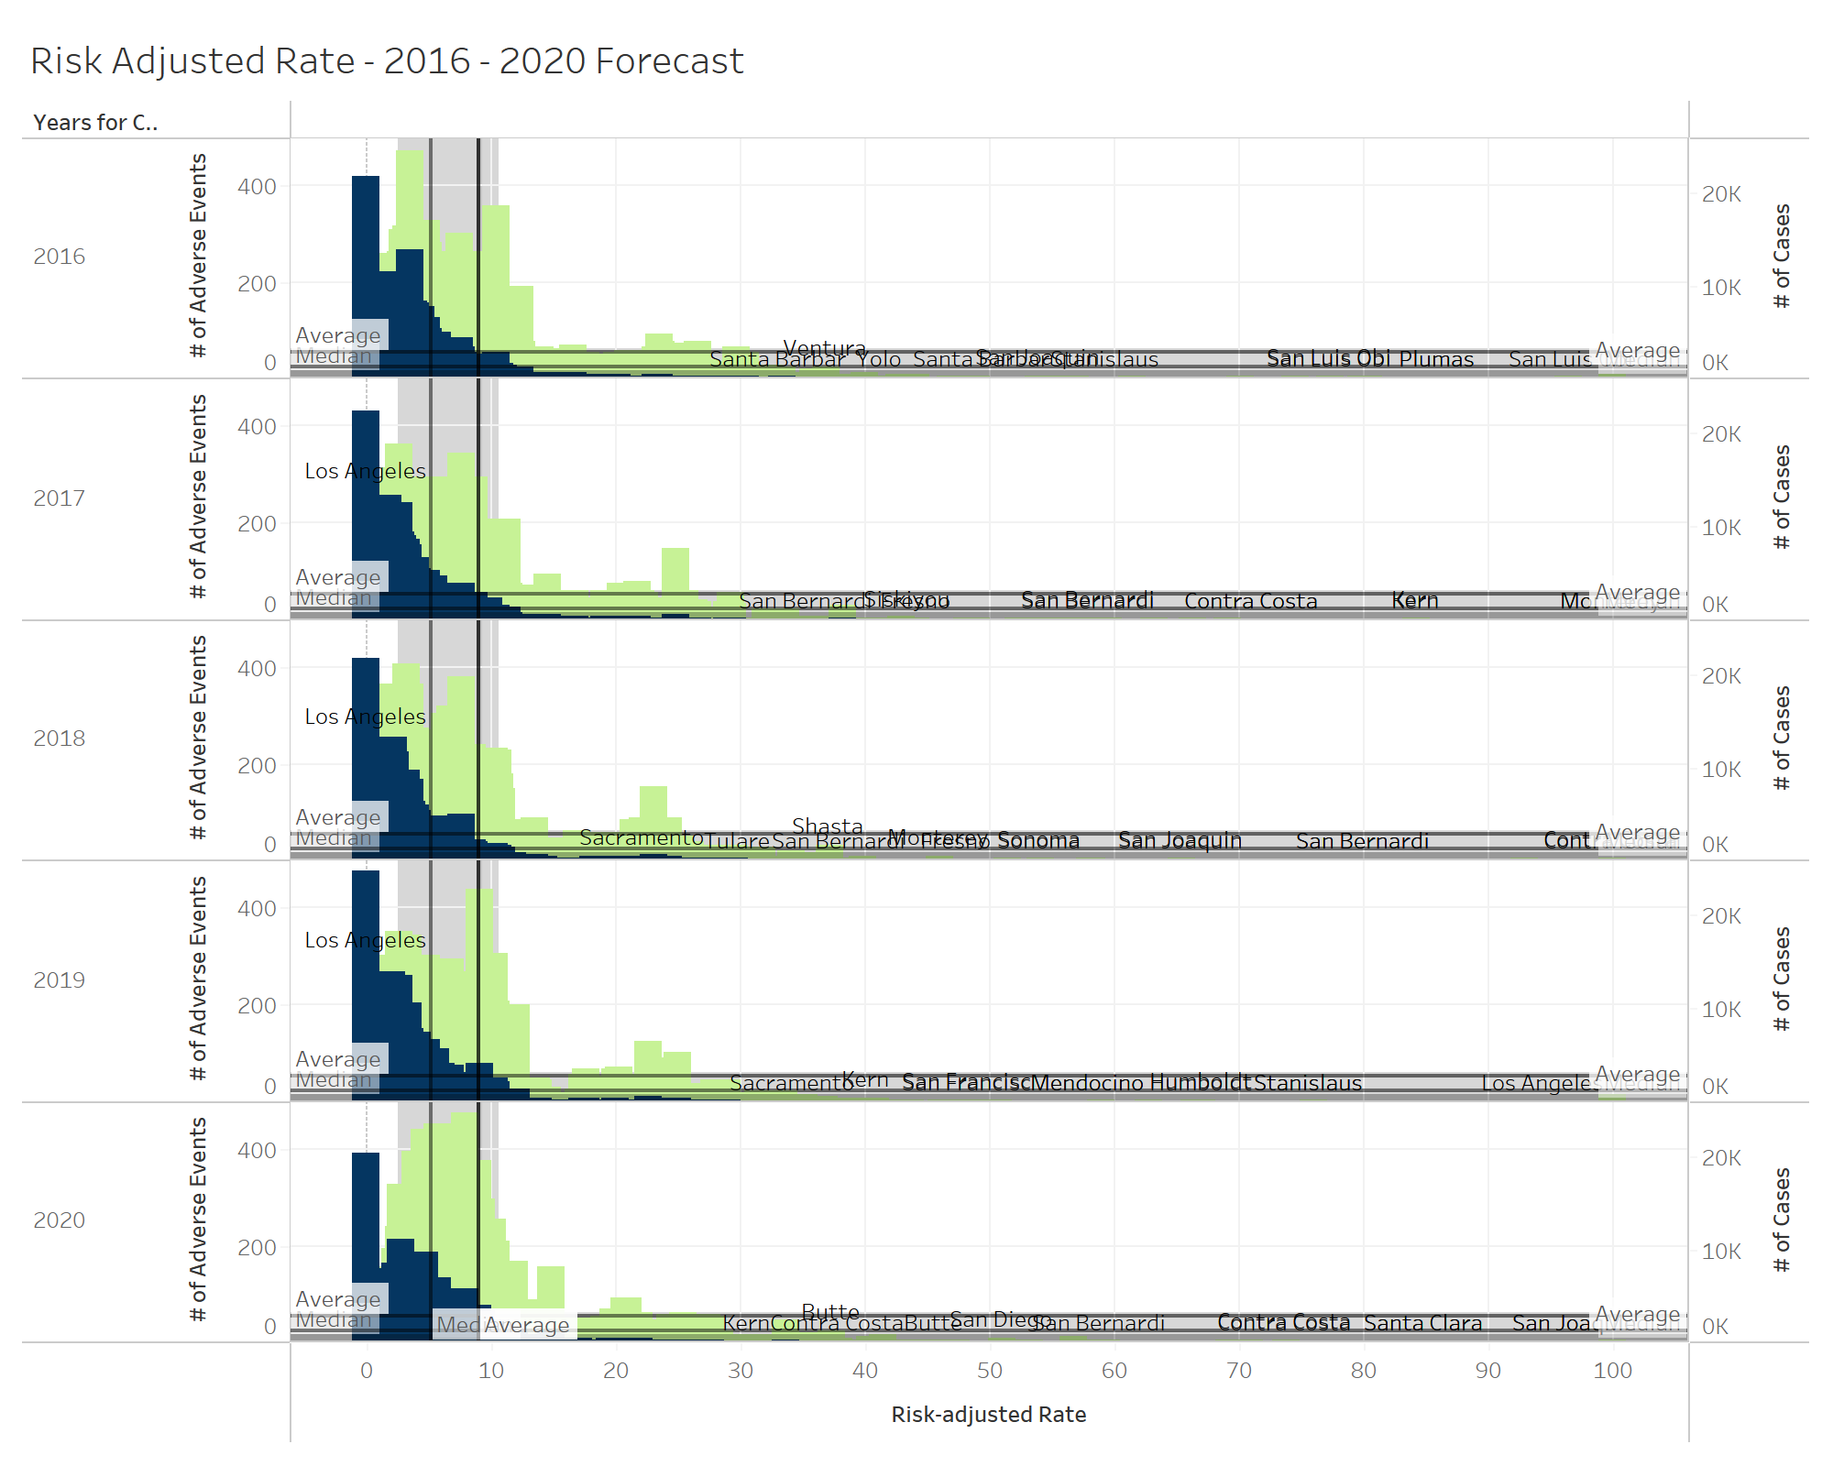

Slide 24
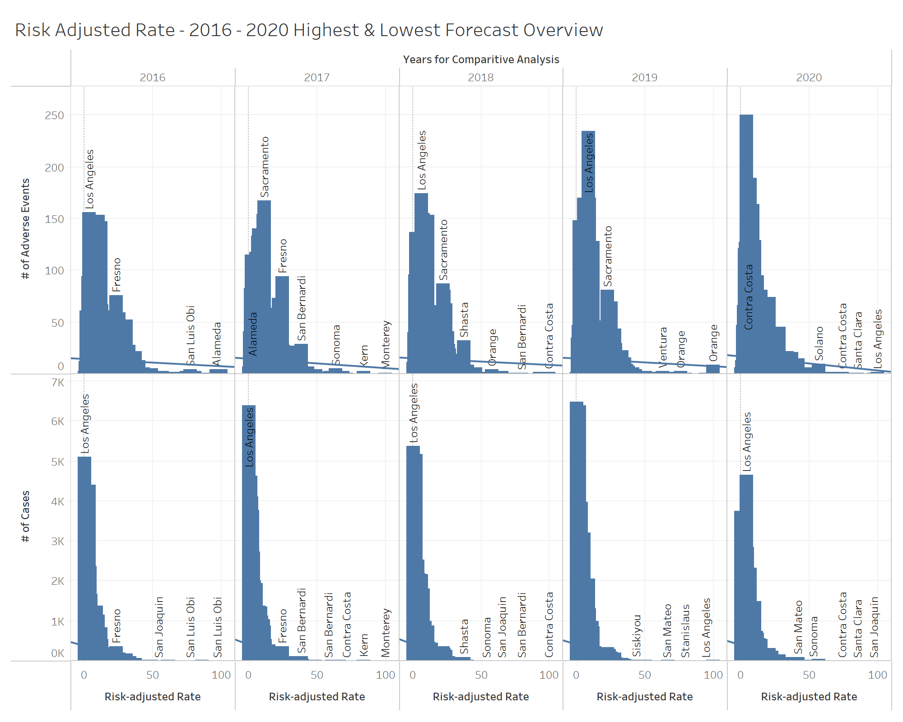

Slide 25
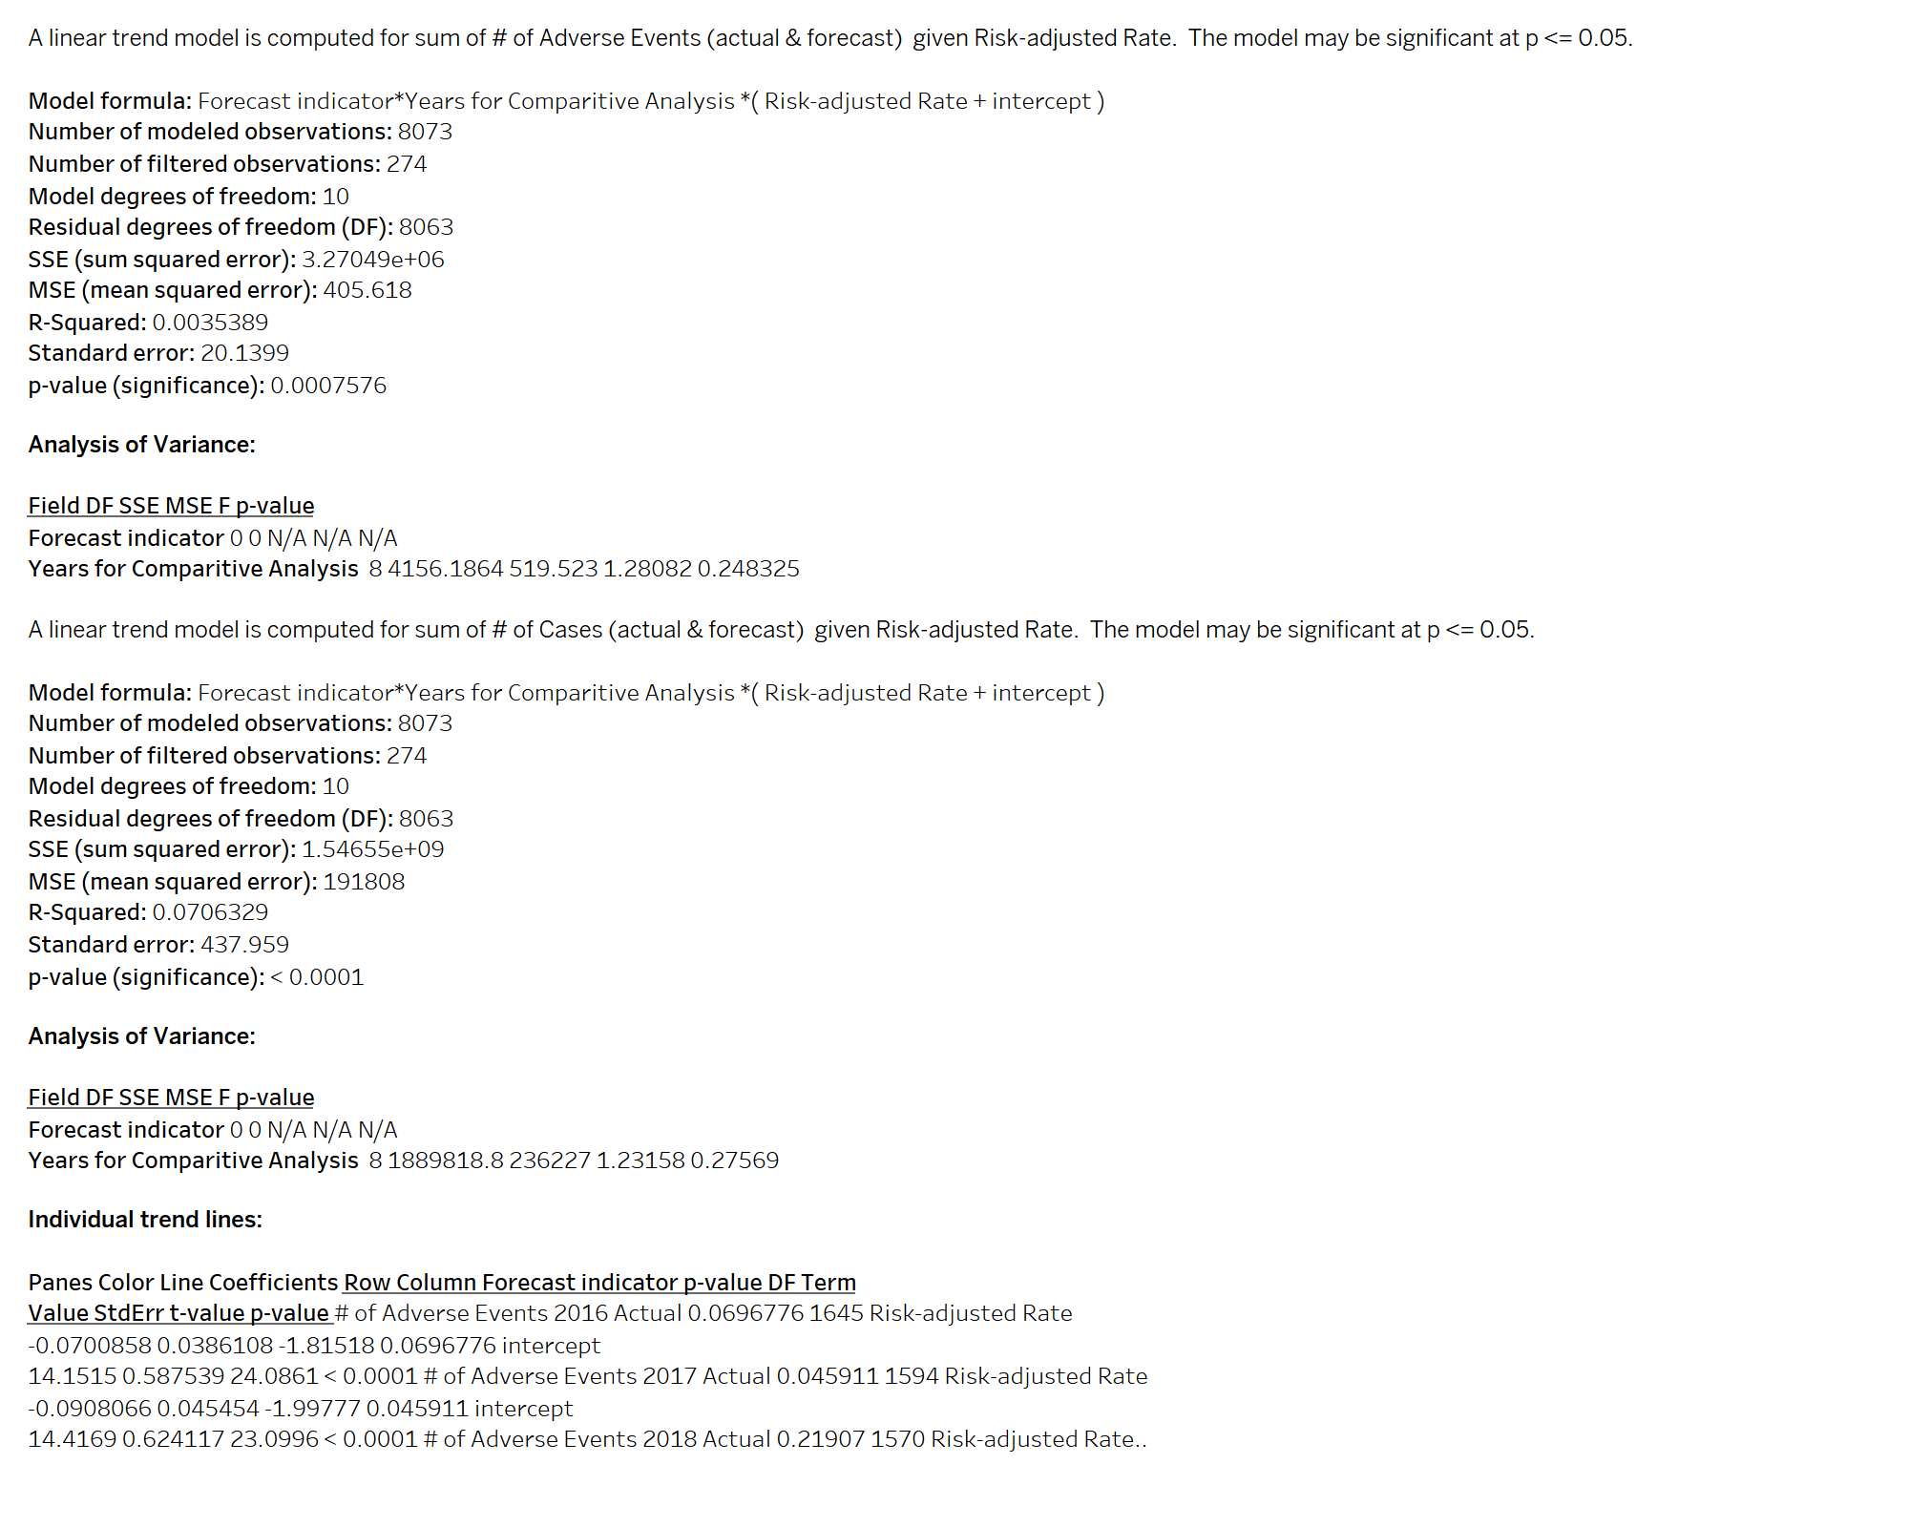

Slide 26
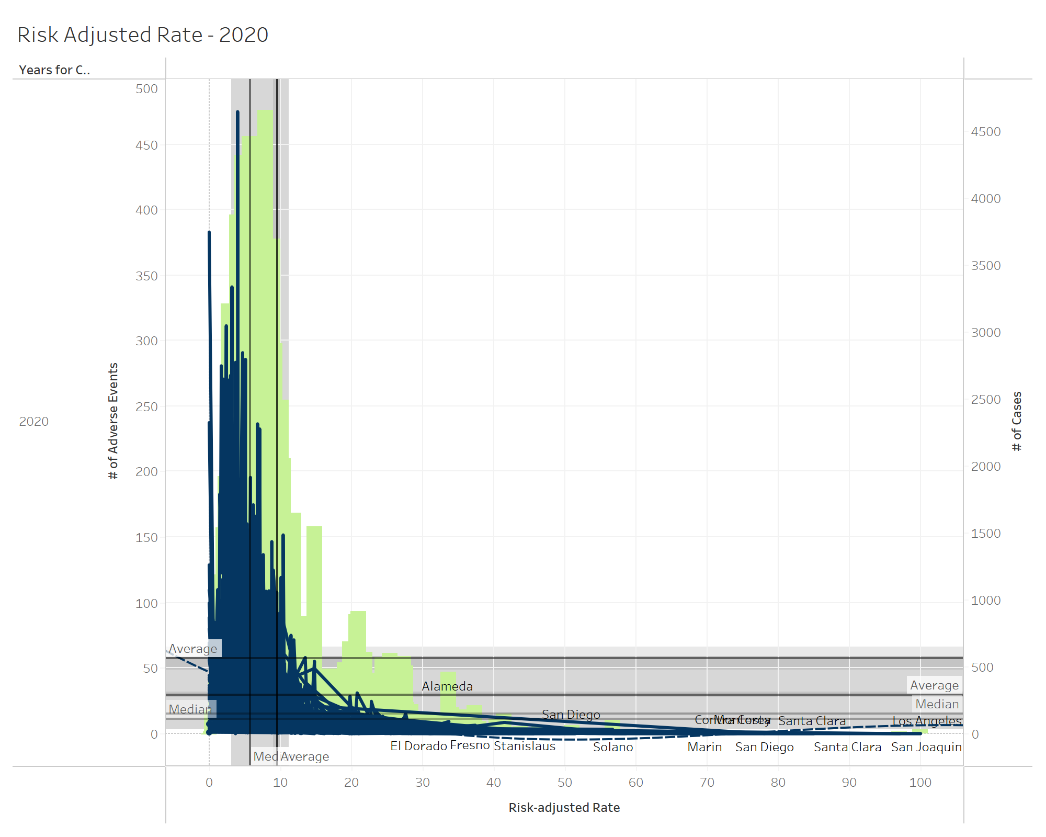

Slide 27
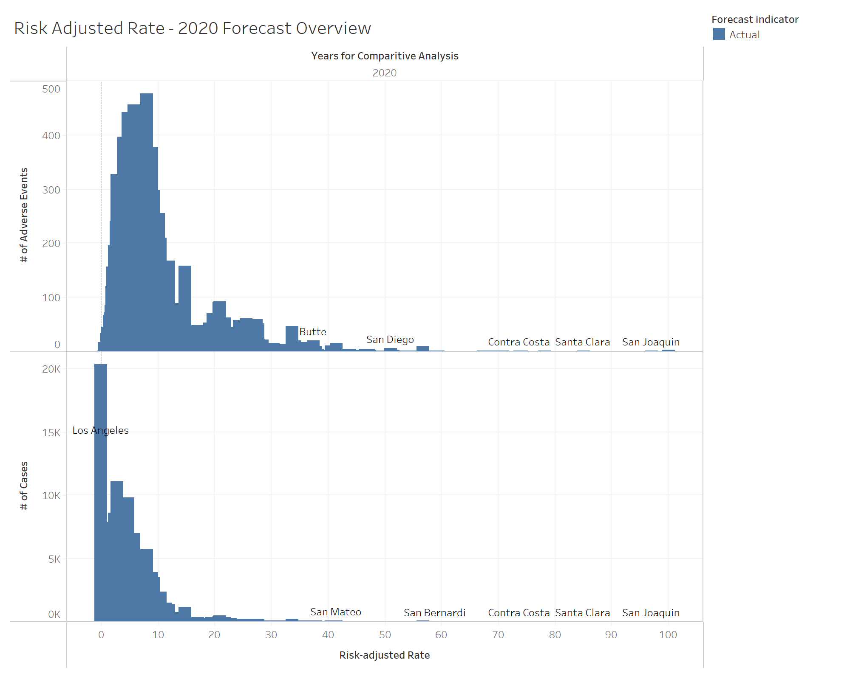

Slide 28
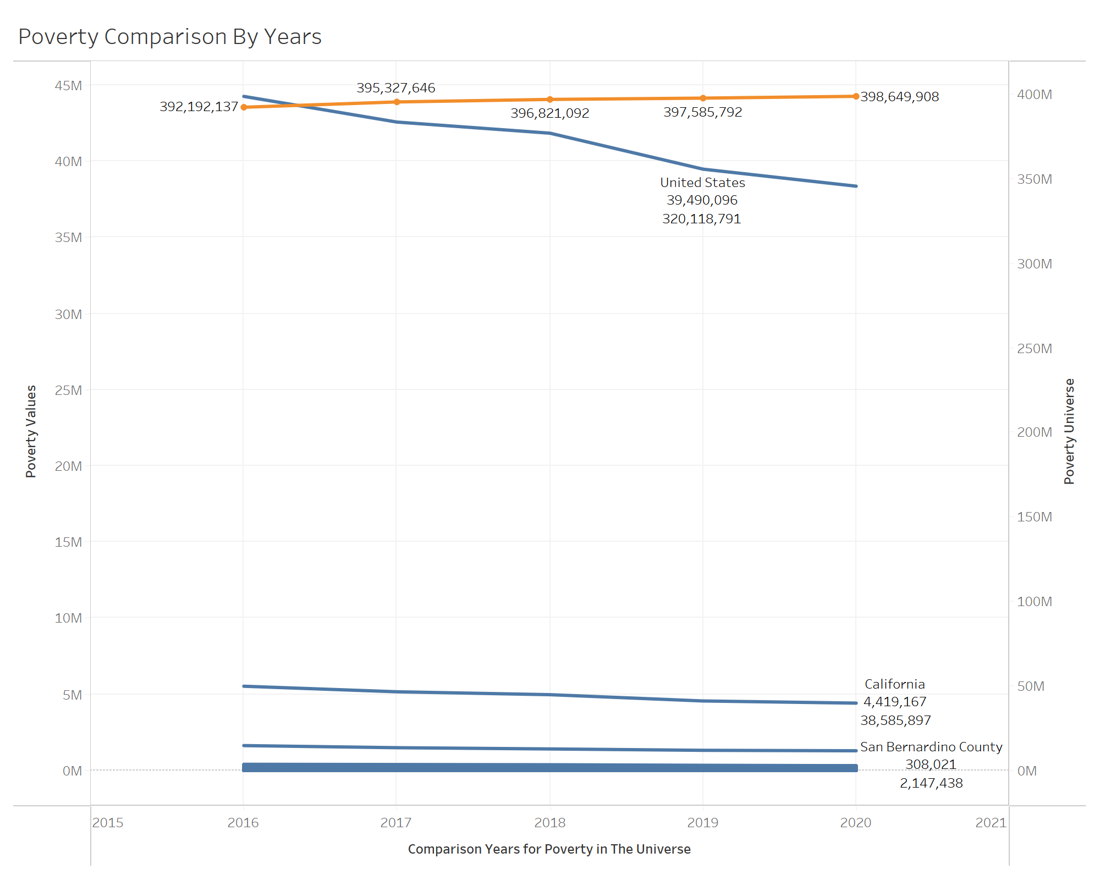

Slide 29
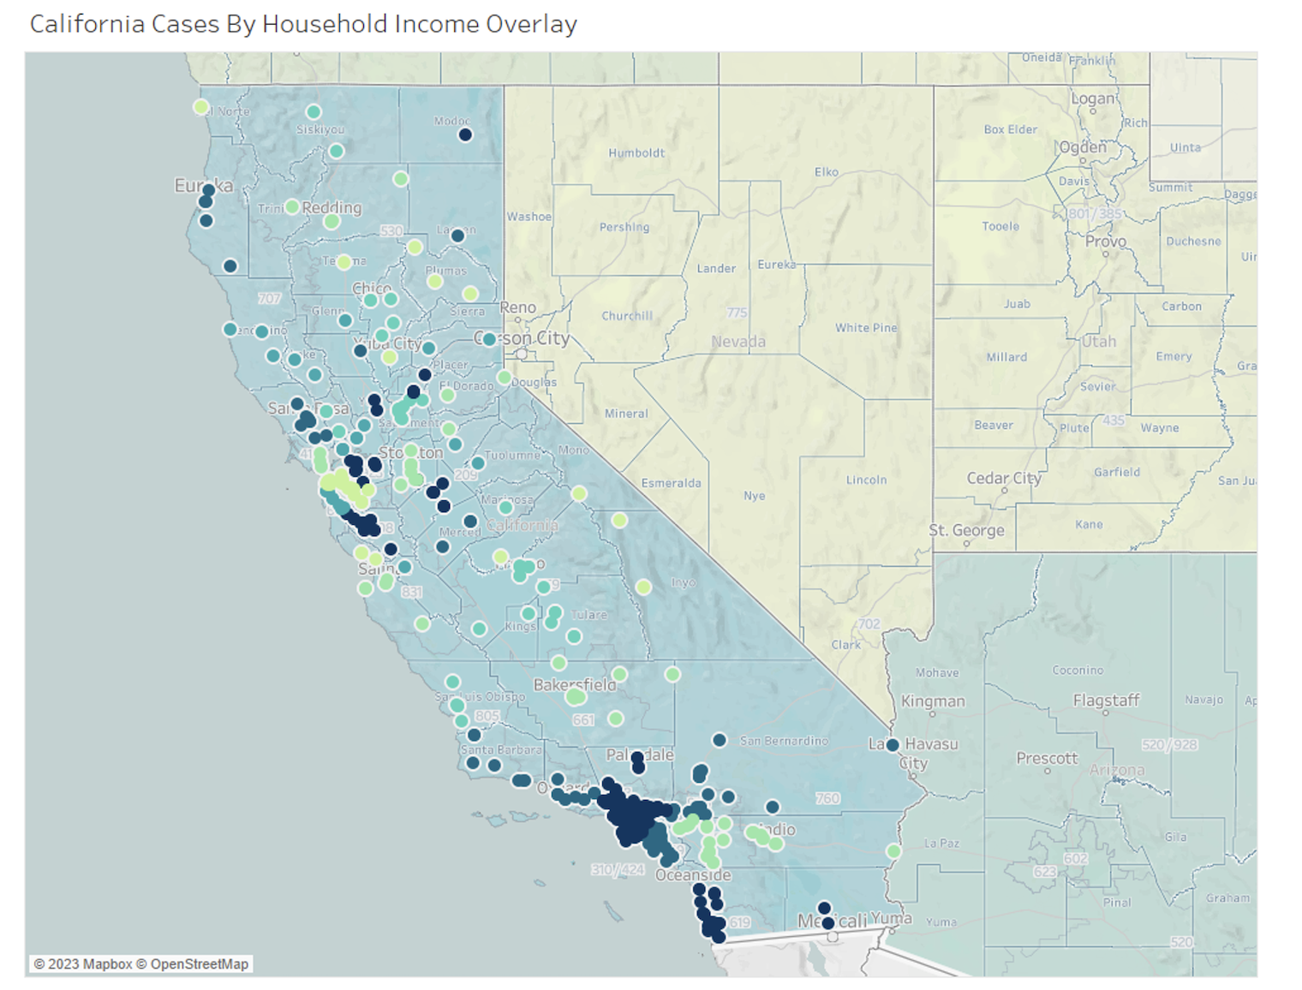

Slide 30

Machine Learning

Slide 31

ML Algorithm
The Machine Learning Algorithm considers Regression Analysis, Time Series Forecasting, and Gaussian Modeling.

Slide 32
Results
As demonstrated in the visualizations, we can conclude that:
counties with higher cases of poverty show lower performance ratings of hospital procedures performed compared to hospitals in counties with less cases of poverty.
higher number of adverse cases and a higher risk adjusted rate are seen in more poverty-ridden counties with worse hospital ratings than in less poverty-ridden counties.

Slide 33

Project Review
Other factors that could potentially affect the data exploration phase and paint a different, perhaps more insightful picture:
Social Determinants of the Health Theory Model
Examining the levels of the following for practitioners:
Training
Education

Slide 34

Questions?

Slide 35

Thank you

